Slide 1
Chapter 2
Conventional Encryption

Slide 2
Outline
Conventional Encryption Principles
Conventional Encryption Algorithms
Cipher Block Modes of Operation
Location of Encryption Devices
Key Distribution

Slide 3
Symmetric Encryption
A.k.a. conventional / secret-key / single-key
Sender and recipient share a common key
All classical encryption algorithms are secret-key-based
Was the only type prior to the invention of public-key in 1970’s
By far most widely used
Notes:
值得注意的是，在公开密钥体系发明之前，也就是70年代之前，可以说对称密钥体系是唯一的一种选择。

Slide 4
Conventional Encryption Principles
An encryption scheme has five ingredients:
  Plaintext
  Encryption algorithm
  Secret key
  Ciphertext
  Decryption algorithm
Security depends on the secrecy of the key, not the secrecy of the algorithm
  Why?
Notes:
依次解释各个名词。
对称密钥的安全使用有两个要求：
首先，需要有一个强加密算法，也就是说，当攻击者知道算法并获得一个或多个密文是，并不能通过破译密文或者算出密钥。
其次，发送者和接收者之间必须通过一个安全的方式获取密钥并且保证密钥安全，如果别人发现了密钥并且知道了算法，所有使用这个密钥的通信都是可读的。
需要指出，对称密钥的安全取决于密钥的保密性而非算法的保密性，也就是说在已知密文和加密/解密算法的基础上不能够破译消息。不需要使算法保密，只需要确保密钥保密。

Slide 5
Some Basic Terminology
Cipher
  Algorithm for transforming plaintext to ciphertext
Encipher (encrypt)
  Converting plaintext to ciphertext
Decipher (decrypt)
  Recovering ciphertext from plaintext
Cryptography
  Study of encryption principles/methods
Cryptanalysis (codebreaking)
  Study of principles/ methods of deciphering ciphertext without knowing key
Cryptology
  Field of both cryptography and cryptanalysis
Notes:
Cryptography 加密学
Cryptanalysis 密码破解

Slide 6
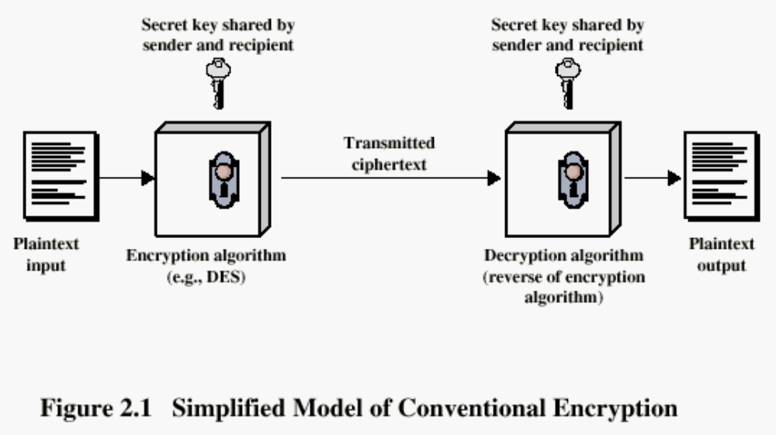
Conventional Encryption Principles

Slide 7
Requirements
Two requirements for secure use of symmetric encryption:
  A strong encryption algorithm
  A secret key known only to sender and receiver
Mathematically we have:
  Y = E_{K}(X)
  X = D_{K}(Y)
Assume encryption algorithm is known
Implies a secure channel to distribute key
Notes:
We assume that it is impractical to decrypt a message on the basis of the cipher- text plus knowledge of the encryption/decryption algorithm, and do not need to keep the algorithm secret; rather we only need to keep the key secret. This feature of symmetric encryption is what makes it feasible for widespread use. It allows easy distribution of s/w and h/w implementations.
Can take a closer look at the essential elements of a symmetric encryption scheme: mathematically it can be considered a pair of functions with: plaintext X, ciphertext Y, key K, encryption algorithm E_{K}, decryption algorithm D_{K}.

Slide 8
Cryptography
Characterize cryptographic systems by:
  Type of encryption operations used
    Substitution / transposition / product
      Some examples will be discussed later
  Number of keys used
    Single-key or secret / two-key or public
  Way in which plaintext is processed
    Block / stream
Notes:
Cryptographic systems can be characterized along these three independent dimensions.

Slide 9
Cryptanalysis
Objective
  Recover key not just message
General approaches:
  Cryptanalytic attack
  Brute-force attack
Notes:
试图找出明文或者密钥的工作成为密码分析或破译，常用的方法主要包括两种，也就是密码分析攻击和蛮力法攻击。

Slide 10
Cryptanalytic Attacks
Ciphertext only
  Only know algorithm & ciphertext, is statistical, know or can identify plaintext
Known plaintext
  Know/suspect plaintext & ciphertext
Chosen plaintext
  Select plaintext and obtain ciphertext
Chosen ciphertext
  Select ciphertext and obtain plaintext
Chosen text
  Select plaintext or ciphertext to en/decrypt
Notes:
上述算法的基础都是要知道加密算法。其次，解释ppt内容。唯密文，已知明文，选择明文，选择密文，选择文本。
其中最困难，也是最容易抵抗的，就是唯密文攻击，因为攻击者掌握的信息量最好，但是在很多情况下，攻击者往往掌握了很多信息。
反过来说，只有相对较弱的算法才不能抵挡唯密文攻击，一般来说，加密算法至少要被设计为能够抵挡已知明文攻击。

Slide 11
More Definitions
Unconditional security
  No matter how much computer power or time is available, the cipher cannot be broken since the ciphertext provides insufficient information to uniquely determine the corresponding plaintext
Computational security
  Given limited computing resources (e.g. time needed for calculations is greater than the age of universe), the cipher cannot be broken
Notes:
无条件安全，一种理想状态。
计算安全
如何做到计算安全：1.破解密文的代价超过被加密信息的代价。2.破解密文需要的时间超出信息的有用寿命。

Slide 12
Brute Force Search
(Exhaustive Key Search)
Always possible to simply try every key
Most basic attack, proportional to key size
Assume either know / recognize plaintext
Average time (1/2)
Key Size (bits) | Number of Alternative Keys | Time required at 1 decryption/µs | Time required at 106 decryptions/µs
32 | 232 = 4.3 × 109 | 231 µs = 35.8 minutes | 2.15 milliseconds
56 | 256 = 7.2 × 1016 | 255 µs = 1142 years | 10.01 hours
128 | 2128 = 3.4 × 1038 | 2127 µs = 5.4 × 1024 years | 5.4 × 1018 years
168 | 2168 = 3.7 × 1050 | 2167 µs = 5.9 × 1036 years | 5.9 × 1030 years
26 letters (permutation) | 26! = 4 × 1026 | 2 × 1026 µs = 6.4 × 1012 years | 6.4 × 106 years

Slide 13
Classical Substitution Ciphers
Letters of plaintext are replaced by other letters or numbers or symbols
  A popular TV show?
If plaintext is viewed as a sequence of bits, then substitution involves replacing plaintext bit patterns with ciphertext bit patterns
Let’s take a look at several real schemes…
Notes:
经典替换密码加密。

Slide 14
Caesar Cipher
Earliest known substitution cipher
  By Julius Caesar
First attested use in military affairs
Replaces each letter by the 3rd letter following
Example:
  meet me after the toga party
  PHHW PH DIWHU WKH WRJD SDUWB
Notes:
Substitution ciphers form the first of the fundamental building blocks. The core idea is to replace one basic unit (letter/byte) with another. Whilst the early Greeks described several substitution ciphers, the first attested use in military affairs of one was by Julius Caesar, described by him in Gallic Wars (cf. Kahn pp83-84). Still call any cipher using a simple letter shift a caesar cipher, not just those with shift 3.

Slide 15
Caesar Cipher
Define transformation (mapping scheme) as:
  a b c d e f g h i j k l m n o p q r s t u v w x y z
  D E F G H I J K L M N O P Q R S T U V W X Y Z A B C
Assign each letter a number
  a b c d e f g h i j k l m n o p q r s t u v w x y z
  0 1 2 3 4 5 6 7 8 9 10 11 12 13 14 15 16 17 18 19 20 21 22 23 24 25
Mathematical form of Caesar cipher:
  c = E(p) = (p + k) mod (26)
  p = D(c) = (c – k) mod (26)
  One mapping scheme → one key/cipher
  How many possible keys/ciphers are there?
Notes:
This mathematical description uses modulo (clock) arithmetic. Here, when you reach Z you go back to A and start again. Mod 26 implies that when you reach 26, you use 0 instead (ie the letter after Z, or 25 + 1 goes to A or 0).
Example: howdy (7,14,22,3,24) encrypted using key f (ie a shift of 5) is MTBID

Slide 16
Cryptanalysis of Caesar Cipher
Only have 26 possible ciphers
  Map A to A, B,…, or Z
Could simply try each in turn
A brute force search
  Given ciphertext, just try all shifts of letters
  Need to recognize when have plaintext
    e.g. break ciphertext “GCUA VQ DTGCM”
    One student works on one cipher each
Notes:
With a caesar cipher, there are only 26 possible keys, of which only 25 are of any use, since mapping A to A etc doesn't really obscure the message! Note this basic rule of cryptanalysis "check to ensure the cipher operator hasn't goofed and sent a plaintext message by mistake"!
Can try each of the keys (shifts) in turn, until can recognise the original message. See Stallings Fig 2.3 for example of search.
Note: as mentioned before, do need to be able to recognise when have an original message (ie is it English or whatever). Usually easy for humans, hard for computers. Though if using say compressed data could be much harder.
Example "GCUA VQ DTGCM" when broken gives "easy to break", with a shift of 2 (key C).

Slide 17
Monoalphabetic Cipher
Rather than just shifting the alphabet
Could shuffle (jumble) the letters arbitrarily
Each plaintext letter maps to a different random ciphertext letter
Hence key is 26 letters long
  Plain: a b c d e f g h i j k l m n o p q r s t u v w x y z
  Cipher:D K V Q F I B J W P E S C X H T M Y A U O L R G Z N
  Plaintext: ifwewishtoreplaceletters
  Ciphertext: WIRFRWAJUHYFTSDVFSFUUFYA
How many possible keys in total?
Notes:
单表置换密码

Slide 18
Monoalphabetic Cipher Security
A total of 26! = 4^1026 keys
With so many keys, one might think it is secure
But would be !!!WRONG!!!
Problem is language characteristics
Notes:
Note that even given the very large number of keys, being 10 orders of magnitude greater than the key space for DES, the monoalphabetic substitution cipher is not secure, because it does not sufficiently obscure the underlying language characteristics.

Slide 19
Language Redundancy and Cryptanalysis
Human languages are redundant
  e.g. "th lrd s m shphrd shll nt wnt"
Letters are not equally commonly used
In English
  E is by far the most common letter
  Followed by T, R, N, I, O, A, S
  Other letters like Z, J, K, Q, X are fairly rare
  Which set of characters are most commonly used in Chinese?
Have tables of single, double & triple letter frequencies for various languages
Notes:
As the example shows, we don't actually need all the letters in order to understand written English text. Here vowels were removed, but they're not the only redundancy. cf written Hebrew has no vowels for same reason. Are usually familiar with "party conversations", can hear one person speaking out of hubbub of many, again because of redundancy in aural language also. This redundancy is also the reason we can compress text files, the computer can derive a more compact encoding without losing any information. Basic idea is to count the relative frequencies of letters, and note the resulting pattern.
中文中最常用的10个字：1 的 2 一 3 国 4 在 5 人 6 了 7 有 8 中 9 是 10 年

Slide 20

English Letter Frequencies
Notes:
Note that all human languages have varying letter frequencies, though the number of letters and their frequencies varies. Stallings Figure 2.5 shows English letter frequencies. Seberry & Pieprzyk, "Cryptography - An Introduction to Computer Security", Prentice-Hall 1989, Appendix A has letter frequency graphs for 20 languages (most European & Japanese & Malay).

Slide 21
Use in Cryptanalysis
Key concept
  Monoalphabetic substitution ciphers do not change relative letter frequencies
  Discovered by Arabian scientists in 9th century
  Calculate letter frequencies for ciphertext
  Compare counts/plots against known values
Caesar cipher looks for common peaks/troughs
  Peaks at: A-E-I triple, NO pair, RST triple
  Troughs at: JK, X-Z
Monoalphabetic must identify each letter
  Tables of common double/triple letters help
Notes:
The simplicity and strength of the monoalphabetic substitution cipher meant it dominated cryptographic use for the first millenium AD. It was broken by Arabic scientists. The earliest known description is in Abu al-Kindi's "A Manuscript on Deciphering Cryptographic Messages", published in the 9th century but only rediscovered in 1987 in Istanbul, but other later works also attest to their knowledge of the field. Monoalphabetic ciphers are easy to break because they reflect the frequency data of the original alphabet. The cryptanalyst looks for a mapping between the observed pattern in the ciphertext, and the known source language letter frequencies. If English, look for peaks at: A-E-I triple, NO pair, RST triple, and troughs at: JK, X-Z.

Slide 22
Example Cryptanalysis
Given ciphertext:
  UZQSOVUOHXMOPVGPOZPEVSGZWSZOPFPESXUDBMETSXAIZ
  VUEPHZHMDZSHZOWSFPAPPDTSVPQUZWYMXUZUHSX
  EPYEPOPDZSZUFPOMBZWPFUPZHMDJUDTMOHMQ
Count relative letter frequencies (see text)
  Guess which two individual letters are for e & t (with the highest frequencies)?
    P & Z
  Guess what “ZW” is for?
    “th” and hence “ZWP” is “the”
  Proceed with trial and error finally get:
  it was disclosed yesterday that several informal but direct contacts have been made with political
  representatives of the viet cong in moscow
Notes:
Illustrate the process with this example from the text in Stallings section 2.2.

Slide 23
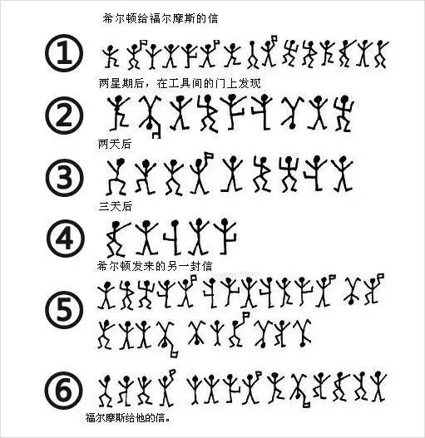
Sherlock Holmes Dancing Man

Slide 24
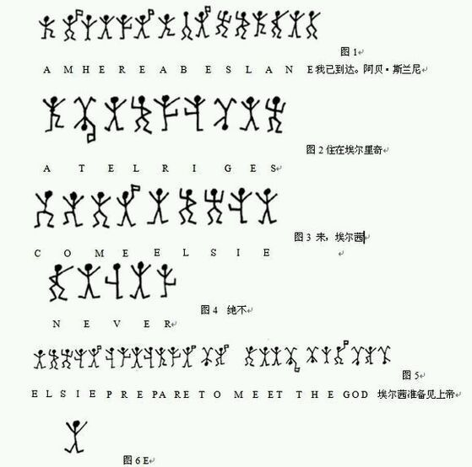
Sherlock Holmes Dancing Man
Notes:
“在英文里最常见的字是e字，按照使用多少的次序排列是：aoidhnrstuycfglmwbkpqxz。e用的次数最多，不管多长的一句独立句子里，难得看见这个e字不作主要字的。”
但这只是在爱伦·坡的时代和小说里面，每天都会有瘾的单词被创造出来，到了福尔摩斯的时代，应该按照福尔摩斯给出的信息来看。
想出这一套方法的人，显然是为了使别人以为它是随手涂抹的儿童画，看不出这些符号传达的信息。然而，只要一看出了这些符号是代表字母的，再应用秘密文字的规律来分析，就不难找到答案。在交给福尔摩斯的第一张纸条上那句话很短，只能稍有把握假定出现频率较高的那个小人代表E。你们也知道，在英文字母中E最常见，它出现的次数多到即使在一个短的句子中也是最常见的。第一张纸条上的十五个符号，其中有四个完全一样，因此把它估计为E是合乎道理的。这些图形中，有的还带一面小旗，有的没有小旗。从小旗的分布来看，带旗的图形可能是用来把这个句子分成一个一个的单词。把这看作一个可以接受的假设，同时记下E是用出现频率较高的那个小人来代表的。
"可是，现在最难的问题来了。因为，除了E以外，英文字母出现次数的顺序并不很清楚。这种顺序，在平常一页印出的文字里和一个短句子里，可能正相反。大致说来，字母按出现次数排列的顺序是T，A，O，I，N，S，H，R，D，L；但是T，A，O，I，出现的次数几乎不相上下。要是把每一种组合都试一遍，直到得出一个意思来，那会是一项无止境的工作。所以，福尔摩斯只好等来了新材料再说。第二次来访的时候，果真给了另外两个短句子和似乎只有一个单词的一句话，就是这几个不带小旗的符号。在这个由五个符号组合的单字中，福尔摩斯找出了第二个和第四个都是E。
这个单词可能是sever（切断），也可能是lever（杠杆），或者never（决不）。毫无疑问，使用末了这个词来回答一项请求的可能性极大，而且种种情况都表明这是丘比特太太写的答复。假如这个判断正确，福尔摩斯们现在就可以说，三个符号分别代表NV、和R。
"甚至在这个时候福尔摩斯的困难仍然很大。但是，一个很妙的想法使福尔摩斯们知道了另外几个字母。福尔摩斯想其假如这些恳求是来自一个在丘比特太太年轻时候就跟她亲近的人的话，那末一个两头是E，当中有三个别的字母的组合很可能就是ELSIE（埃尔茜）这个名字。一检查，发现这个组合曾经三次构成一句话的结尾。这样的一句话肯定是对'埃尔茜'提出的恳求。这一来就找出了L、S和I。可是，究竟恳求什么呢？在'埃尔茜'前面的一个词，只有四个字母，末了的是E。这个词必定是Come（来）无疑。试过其他各种以E结尾的四个字母，都不符合情况。这样福尔摩斯就找出了C、O和M，而且现在可以再来分析第一句话，把它分成单词，还不知道的字母就用点代替。经过这样的处理，这句话就成了这种样子：
．M． ERE ．． ESLNE．．
"现在，第一个字母只能是A。这是最有帮助的发现，因为它在这个短句中出现了三次。第二个词的开头是H也是显而易见的。这一句话现在成了：
AM HERE A．E SLANE．
再把名字中所缺的字母添上：
AM HERE ABE SLANE．
（我已到达。阿贝·斯兰尼。）
现在有了这么多字母，能够很有把握地解释第二句话
了。这一句读出来是这样的：
A． ELRI． ES．
看这一句中，只能在缺字母的地方加上T和G才有
意义（意为：住在埃尔里奇。），并且假定这个名字是写信人住的地方或者旅店。"
有充分理由猜想阿贝·斯兰尼是美国人，因为阿贝是
个美国式的编写，而且这些麻烦的起因又是从美国寄来一封信。也有充分理由认为这件事带有犯罪的内情。女主人说的那些暗示她的过去的话和她拒绝把实情告诉她丈夫，都使人们从这方面去想。此人是芝加哥最危险的骗子。'就在接到回电的那天晚上，希尔顿·丘比特寄来了阿贝·斯兰尼最后画的一行小人。用已经知道的这些字母译出来就成了这样的一句话：
ELSIE． RE． ARE TO MEET THYGO.
再添上P和D，这句话就完整了（意为：埃尔茜，准备见上帝。）

Slide 25
Transposition Ciphers
Now consider classical transposition or permutation ciphers
These hide the message
  By rearranging the letter order
  Without altering the actual letters used
Does the cipher text have the same frequency distribution as the original text?
Is it subject to the language frequency cryptanalysis?
Notes:
All the techniques examined so far involve the substitution of a ciphertext symbol for a plaintext symbol. A very different kind of mapping is achieved by performing some sort of permutation on the plaintext letters. This technique is referred to as a transposition cipher, and form the second basic building block of ciphers. The core idea is to rearrange the order of basic units (letters/bytes/bits) without altering their actual values.

Slide 26
Rail Fence Cipher
Write message letters out diagonally over a number of rows
Then read off cipher row by row
  E.g. write message out as:
  m e m a t r h t g p r y
  e t e f e t e o a a t
Giving ciphertext
  MEMATRHTGPRY ETEFETEOAAT
Notes:
The simplest such cipher is the rail fence technique, in which the plaintext is written down as a sequence of diagonals and then read off as a sequence of rows.
The example message is: "meet me after the toga party" with a rail fence of depth 2.
This sort of thing would be trivial to cryptanalyze.

Slide 27
Row Transposition Ciphers
A more complex transposition
Write letters of message out in rows over a specified number of columns
Then reorder the columns according to some key before reading off the rows
  Key: 3 4 2 1 5 6 7
  Plaintext: a t t a c k p
  o s t p o n e
  d u n t i l t
  w o a m x y z
  Ciphertext: TTNAAPTMTSUOAODWCOIXKNLYPETZ
Method (algorithm) is not a secret, but key is the key!
^{Read starting} from the 3rd column, then the 4th one, and so on.
Notes:
A more complex transposition cipher is to write the message in a rectangle, row by row, and read the message off shuffling the order of the columns in each row.
A pure transposition cipher is easily recognized because it has the same letter frequencies as the original plaintext. For the type of columnar transposition just shown, cryptanalysis is fairly straightforward and involves laying out the ciphertext in a matrix and playing around with column positions. Digram and trigram frequency tables can be useful.

Slide 28
Product Ciphers (Hybrid Scheme)
Ciphers using substitutions or transpositions are not secure because of language characteristics
Hence consider using several ciphers in succession to make harder, but:
  Two substitutions make a more complex substitution
  Two transpositions make a more complex transposition
  But a substitution followed by a transposition makes a new much harder cipher
This is the bridge from classical to modern ciphers!
Notes:
Have seen that ciphers based on just substitutions or transpositions are not secure, and can be attacked because they do not sufficient obscure the underlying language structure
So consider using several ciphers in succession to make harder.
A substitution followed by a transposition is known as a Product Cipher, and makes a new much more secure cipher, and forms the bridge to modern ciphers.

Slide 29
Rotor Machines
Before modern ciphers, rotor machines were most common complex ciphers in use
Widely used in WW2
  German Enigma, Allied Hagelin, Japanese Purple
Implemented a very complex, varying substitution cipher
Used a series of cylinders, each giving one substitution, which rotated and changed after each letter was encrypted
With 3 cylinders have 26³=17576 alphabets
Notes:
The next major advance in ciphers required use of mechanical cipher machines which enabled to use of complex varying substitutions.
A rotor machine consists of a set of independently rotating cylinders through which electrical pulses can flow. Each cylinder has 26 input pins and 26 output pins, with internal wiring that connects each input pin to a unique output pin. If we associate each input and output pin with a letter of the alphabet, then a single cylinder defines a monoalphabetic substitution. After each input key is depressed, the cylinder rotates one position, so that the internal connections are shifted accordingly. The power of the rotor machine is in the use of multiple cylinders, in which the output pins of one cylinder are connected to the input pins of the next, and with the cylinders rotating like an “odometer”, leading to a very large number of substitution alphabets being used, eg with 3 cylinders have 26³=17576 alphabets used.
They were extensively used in world war 2, and the history of their use and analysis is one of the great stories from WW2.

Slide 30

Hagelin Rotor Machine
Notes:
This photo of an Allied Hagelin machine was taken by Lawrie Brown at Eurocrypt'93 in Norway. Note pen for scale, and the rotating cipher wheels near the front.

Slide 31
Steganography
(藏头/尾诗)
An alternative to encryption
Hides existence of message
  Using only a subset of letters/words in a longer message marked in some way
  Using invisible ink
  Hiding in LSB in graphic image or sound file
Has drawbacks
  High overhead to hide relatively few info bits
Notes:
Steganography is an alternative to encryption which hides the very existence of a message by some means. There are a large range of techniques for doing this.
Steganography has a number of drawbacks when compared to encryption. It requires a lot of overhead to hide a relatively few bits of information.
Also, once the system is discovered, it becomes virtually worthless, although a message can be first encrypted and then hidden using steganography.

Slide 32
Classical Feistel Cipher Structure
By Horst Feistel of IBM in 1973
  Virtually all conventional block encryption algorithms (including DES) use this structure
The realization of a Feistel Network depends on
  the choice of a number of parameters and design features

Slide 33
Feistel Cipher Structure
Block size
  larger block sizes mean greater security
Key Size
  larger key size means greater security
Number of rounds
  multiple rounds offer increasing security
Subkey generation algorithm
  greater complexity will lead to greater difficulty of cryptanalysis.
Fast software encryption/decryption
  the speed of execution of the algorithm becomes a concern
Notes:
分组大小
密钥大小
迭代次数
子密钥产生算法
轮函数

Slide 34
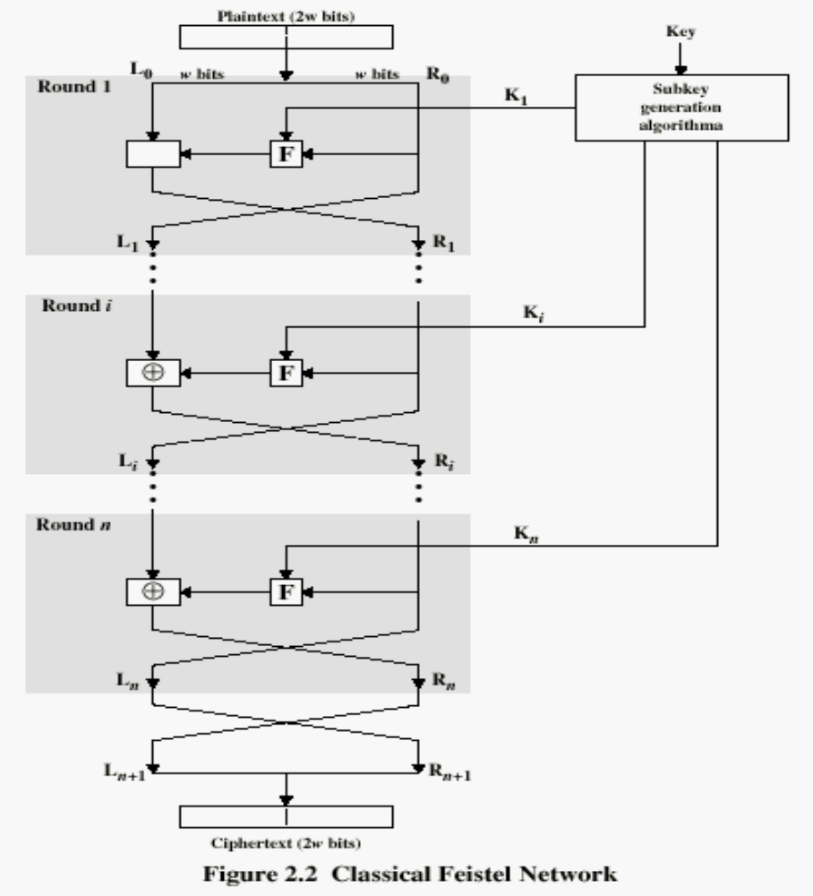

Slide 35
Conventional Encryption Algorithms
Data Encryption Standard (DES)
  The most widely used encryption scheme
  The algorithm is reffered to as the Data Encryption Algorithm (DEA)
  DES is a block cipher
  The plaintext is processed in 64-bit blocks
  The key is 56-bits in length (original version)

Slide 36
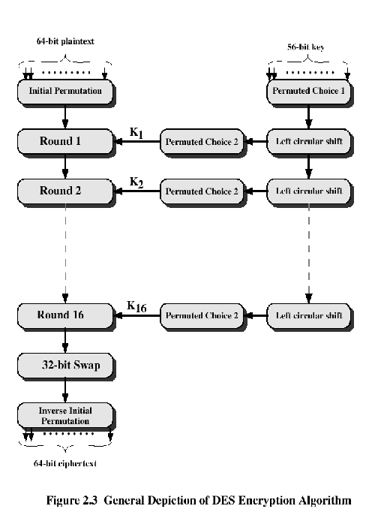

Slide 37
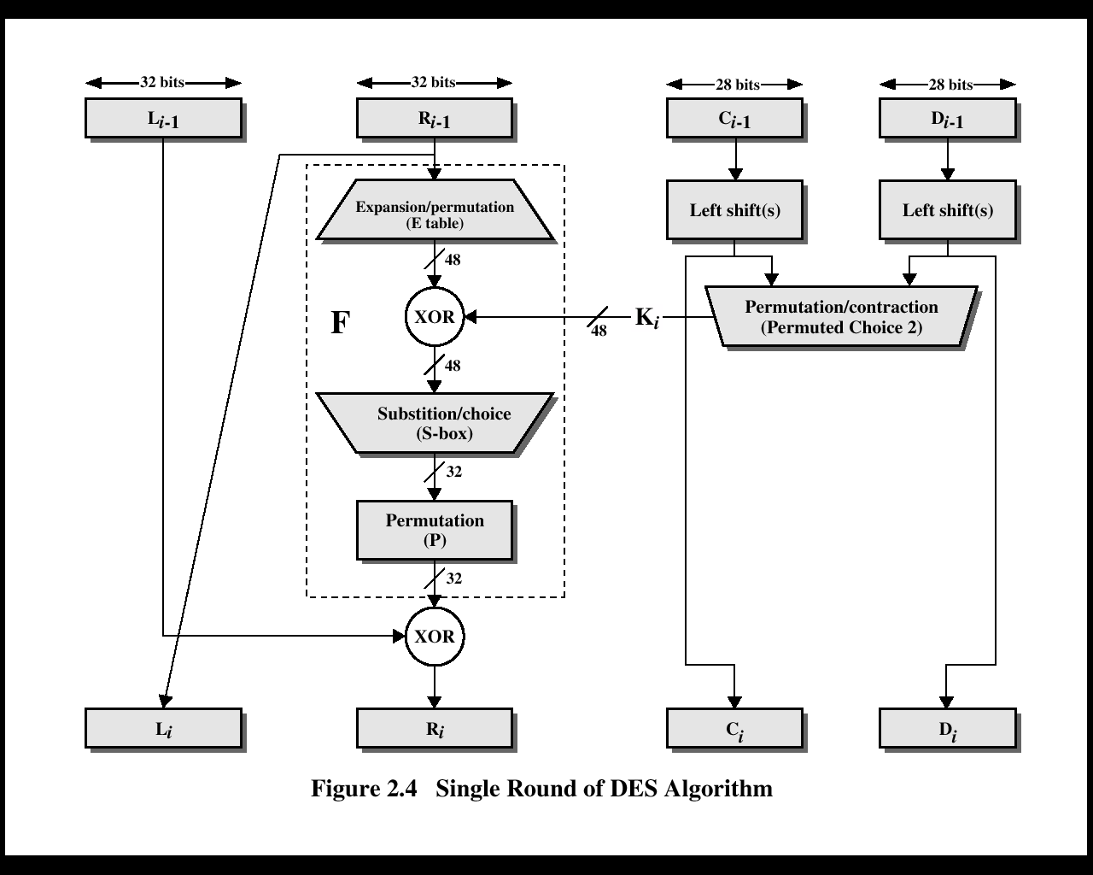

Slide 38

DES
Mathematically, the overall processing at each iteration:
  Li = Ri-1
  Ri = Li-1 F(Ri-1, Ki)
Concerns about:
  The algorithm and the key length (56-bits)

Slide 39
Avalanche Effect
An important desirable property of encryption algorithm
  A change of one input or key bit results in changing approx half output bits
  Making attacks by guessing keys impossible
DES exhibits strong avalanche
Notes:
A desirable property of any encryption algorithm is that a small change in either the plaintext or the key should produce a significant change in the ciphertext. In particular, a change in one bit of the plaintext or one bit of the key should produce a change in many bits of the ciphertext. If the change were small, this might provide a way to reduce the size of the plaintext or key space to be searched. DES exhibits a strong avalanche effect, as may be seen in Stallings Table 3.5.

Slide 40
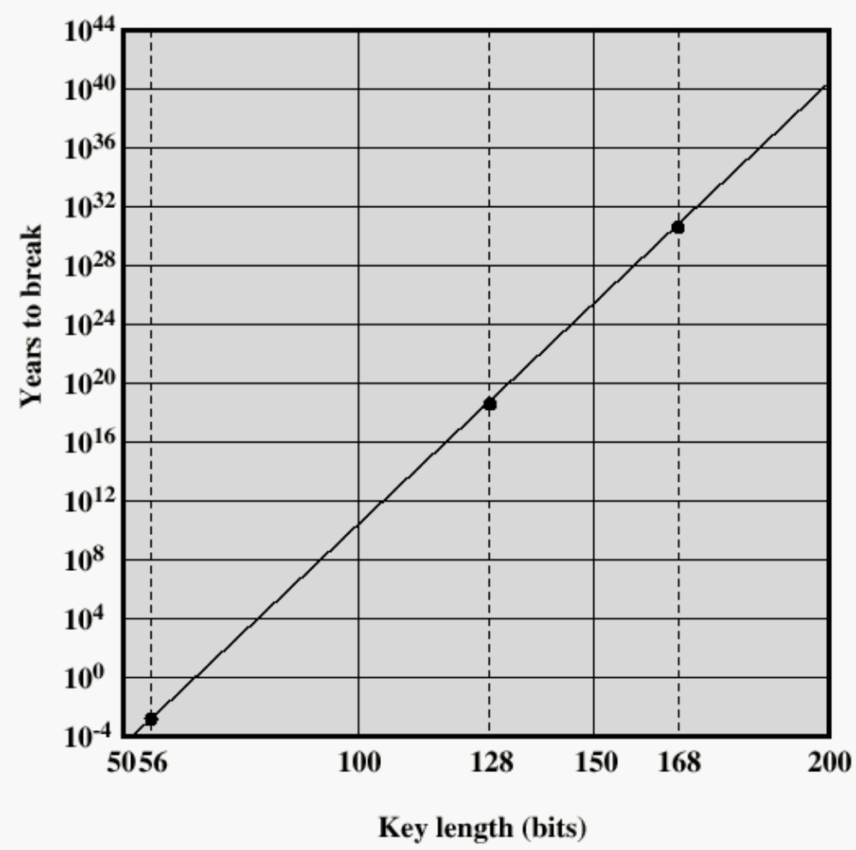
Time to break a code (10⁶ decryptions/µs)

Slide 41
Strength of DES – Key Size
56-bit keys have 2⁵⁶ = 7.2 x 10¹⁶ values
  Brute force search looks hard
Recent advances have shown possibilities
  In 1997 on the Internet in a few months
  In 1998 on dedicated h/w (EFF) in a few days
  In 1999 above combined in 22 hrs!
Still must be able to recognize plaintext
Notes:
Since its adoption as a federal standard, there have been lingering concerns about the level of security provided by DES in two areas: key size and the nature of the algorithm.
With a key length of 56 bits, there are 2^56 possible keys, which is approximately 7.2*10^16 keys. Thus a brute-force attack appeared impractical.
However DES was finally and definitively proved insecure in July 1998, when the Electronic Frontier Foundation (EFF) announced that it had broken a DES encryption using a special-purpose "DES cracker" machine that was built for less than $250,000. The attack took less than three days. The EFF has published a detailed description of the machine, enabling others to build their own cracker [EFF98].
There have been other demonstrated breaks of the DES using both large networks of computers & dedicated h/w, including:
- 1997 on a large network of computers in a few months
- 1998 on dedicated h/w (EFF) in a few days
- 1999 above combined in 22hrs!
It is important to note that there is more to a key-search attack than simply running through all possible keys. Unless known plaintext is provided, the analyst must be able to recognize plaintext as plaintext.
Clearly must now consider alternatives to DES, the most important of which are AES and triple DES.

Slide 42
Strength of DES –
Analytic Attacks
Several analytic attacks utilizing some deep structure of the cipher
  By gathering information about encryptions
  Can eventually recover some/all of the sub-key bits
  If necessary then exhaustively search for the rest
Statistical attacks
  Differential cryptanalysis
  Linear cryptanalysis
  Related key attacks
Must now consider alternatives to DES
Notes:
Another concern is the possibility that cryptanalysis is possible by exploiting the characteristics of the DES algorithm. The focus of concern has been on the eight substitution tables, or S-boxes, that are used in each iteration. These techniques utilise some deep structure of the cipher by gathering information about encryptions so that eventually you can recover some/all of the sub-key bits, and then exhaustively search for the rest if necessary. Generally these are statistical attacks which depend on the amount of information gathered for their likelihood of success. Attacks of this form include differential cryptanalysis. linear cryptanalysis, and related key attacks.

Slide 43
Alternatives to DES
A replacement for DES was needed
  Have theoretical attacks that can break it
  have demonstrated exhaustive key search attacks
A strengthened DES
  Triple-DEA (Triple-DES)
Notes:
Since its adoption as a federal standard, there have been lingering concerns about the level of security provided by DES in two areas: key size and the nature of the algorithm.
With a key length of 56 bits, there are 2^56 possible keys, which is approximately 7.2*10^16 keys. Thus a brute-force attack appeared impractical.
However DES was finally and definitively proved insecure in July 1998, when the Electronic Frontier Foundation (EFF) announced that it had broken a DES encryption using a special-purpose "DES cracker" machine that was built for less than $250,000. The attack took less than three days. The EFF has published a detailed description of the machine, enabling others to build their own cracker [EFF98].
There have been other demonstrated breaks of the DES using both large networks of computers & dedicated h/w, including:
- 1997 on a large network of computers in a few months
- 1998 on dedicated h/w (EFF) in a few days
- 1999 above combined in 22hrs!
It is important to note that there is more to a key-search attack than simply running through all possible keys. Unless known plaintext is provided, the analyst must be able to recognize plaintext as plaintext.
Clearly must now consider alternatives to DES, the most important of which are AES and triple DES.

Slide 44
Triple DEA
Use three keys and three executions of the DES algorithm (encrypt-decrypt-encrypt)
    C = ciphertext
    P = Plaintext
    EK[X] = encryption of X using key K
    DK[Y] = decryption of Y using key K
Effective key length of 168 bits (3x56)
C = EK3[DK2[EK1[P]]]

Slide 45
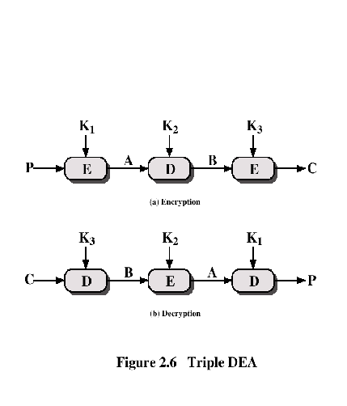
Triple DEA

Slide 46
Alternatives to DES
Triple-DES
  Slow
    Use small blocks
AES Cipher – Rijndael
  Designed by Joan. Daemen and Vincent Rijmen in Belgium
  Has 128/192/256-bit keys, 128-bit data
  An iterative rather than feistel cipher
    Processes data as block of 4 columns of 4 bytes
    Operates on entire data block in every round
Notes:
Since its adoption as a federal standard, there have been lingering concerns about the level of security provided by DES in two areas: key size and the nature of the algorithm.
With a key length of 56 bits, there are 2^56 possible keys, which is approximately 7.2*10^16 keys. Thus a brute-force attack appeared impractical.
However DES was finally and definitively proved insecure in July 1998, when the Electronic Frontier Foundation (EFF) announced that it had broken a DES encryption using a special-purpose "DES cracker" machine that was built for less than $250,000. The attack took less than three days. The EFF has published a detailed description of the machine, enabling others to build their own cracker [EFF98].
There have been other demonstrated breaks of the DES using both large networks of computers & dedicated h/w, including:
- 1997 on a large network of computers in a few months
- 1998 on dedicated h/w (EFF) in a few days
- 1999 above combined in 22hrs!
It is important to note that there is more to a key-search attack than simply running through all possible keys. Unless known plaintext is provided, the analyst must be able to recognize plaintext as plaintext.
Clearly must now consider alternatives to DES, the most important of which are AES and triple DES.

Slide 47
Block vs. Stream Ciphers
Block ciphers
  Process messages in blocks, each of which is then en/decrypted
  Like a substitution on very big characters
    64-bits or more
      Need a table of 2^64 entries for a 64-bit block
    Instead, create from smaller building blocks
      Using the idea of a product cipher
  Many current ciphers are block ciphers
    A wide range of applications
Stream ciphers
  Process messages a bit or byte at a time when en/decrypting
Notes:
Block ciphers work a on block / word at a time, which is some number of bits. All of these bits have to be available before the block can be processed. Stream ciphers work on a bit or byte of the message at a time, hence process it as a “stream”. Block ciphers are currently better analysed, and seem to have a broader range of applications, hence focus on them.

Slide 48

Ideal Block Cipher
Expansion (E-table)
Permutation (P-box)
Substitution (S-box)
Notes:
Feistel refers to an n-bit general substitution as an ideal block cipher, because it allows for the maximum number of possible encryption mappings from the plaintext to ciphertext block. A 4-bit input produces one of 16 possible input states, which is mapped by the substitution cipher into a unique one of 16 possible output states, each of which is represented by 4 ciphertext bits. The encryption and decryption mappings can be defined by a tabulation, as shown in Stallings Figure 3.1. It illustrates a tiny 4-bit substitution to show that each possible input can be arbitrarily mapped to any output - which is why its complexity grows so rapidly.

Slide 49
Substitution-Permutation
(S-P) Ciphers
S-P: substitution-permutation
  Two primitive cryptographic operations
    Substitution (S-box)
    Permutation (P-box)
  Introduced by Claude Shannon in 1949 paper
  Form the basis of modern block ciphers
  Provide confusion & diffusion of message & key
Notes:
Claude Shannon’s 1949 paper has the key ideas that led to the development of modern block ciphers. Critically, it was the technique of layering groups of S-boxes separated by a larger P-box to form the S-P network, a complex form of a product cipher. He also introduced the ideas of confusion and diffusion, notionally provided by S-boxes and P-boxes (in conjunction with S-boxes).

Slide 50
Confusion and Diffusion
Cipher needs to completely obscure statistical properties of the original message
  A one-time pad does this
More practically, Shannon suggested combining S & P elements to obtain:
  Diffusion
    Dissipates statistical structure of plaintext over bulk of ciphertext
  Confusion
    Makes relationship between ciphertext and key as complex as possible
Notes:
The terms diffusion and confusion were introduced by Claude Shannon to capture the two basic building blocks for any cryptographic system. Every block cipher involves a transformation of a block of plaintext into a block of ciphertext, where the transformation depends on the key. The mechanism of diffusion seeks to make the statistical relationship between the plaintext and ciphertext as complex as possible in order to thwart attempts to deduce the key. Confusion seeks to make the relationship between the statistics of the ciphertext and the value of the encryption key as complex as possible, again to thwart attempts to discover the key.
So successful are diffusion and confusion in capturing the essence of the desired attributes of a block cipher that they have become the cornerstone of modern block cipher design.

Slide 51
Other Symmetric Block Ciphers
International Data Encryption Algorithm (IDEA)
  128-bit key
  Used in PGP
Blowfish
  Easy to implement
  High execution speed
  Run in less than 5K of memory

Slide 52
Other Symmetric Block Ciphers
RC5
  Suitable for hardware and software
  Fast, simple
  Adaptable to processors of different word lengths
  Variable number of rounds
  Variable-length key
  Low memory requirement
  High security
  Data-dependent rotations
Cast-128
  Key size from 40 to 128 bits
  The round function differs from round to round

Slide 53
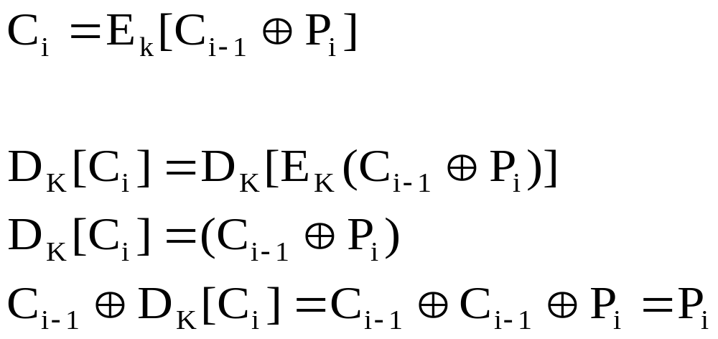
Cipher Block Chaining Modes of Operation
Cipher Block Chaining (CBC) Mode
  The input to the encryption algorithm is the XOR of the current plaintext block and the preceding ciphertext block.
  Repeating pattern of 64-bits are not exposed

Slide 54
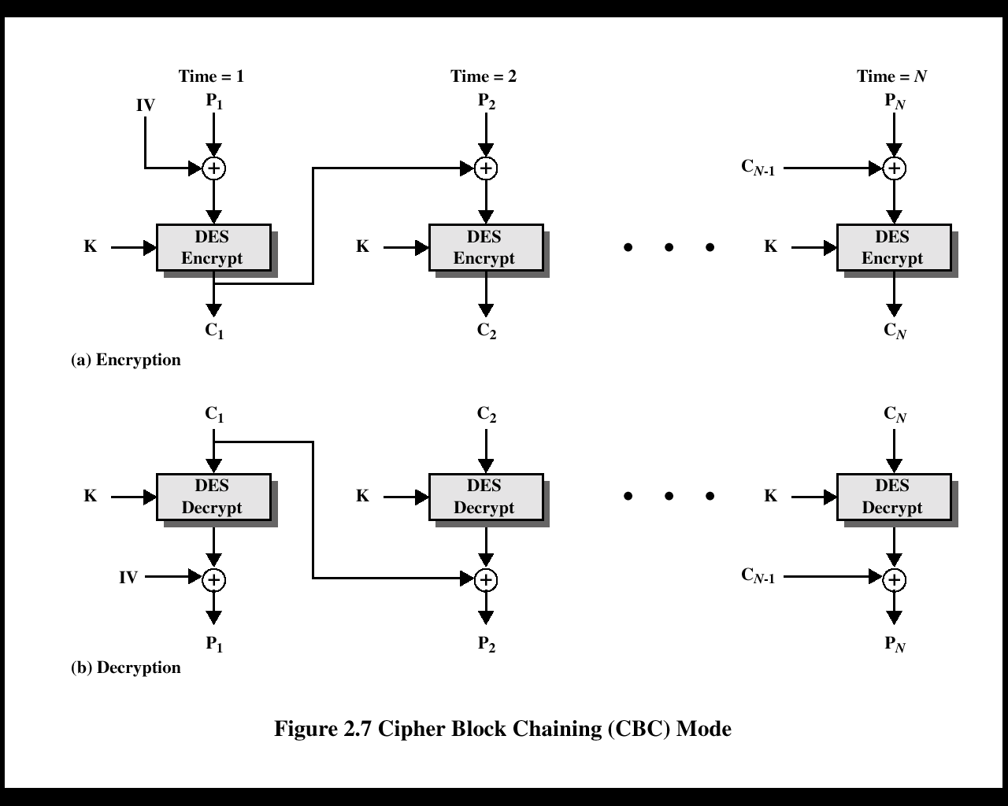

Slide 55
Location of Encryption Device
Link encryption:
  A lot of encryption devices
  High level of security
  Decrypt each packet at every switch
End-to-end encryption
  The source encrypts and the receiver decrypts
  Payload encrypted
  Header in the clear
High Security
  Both link and end-to-end encryption are needed

Slide 56
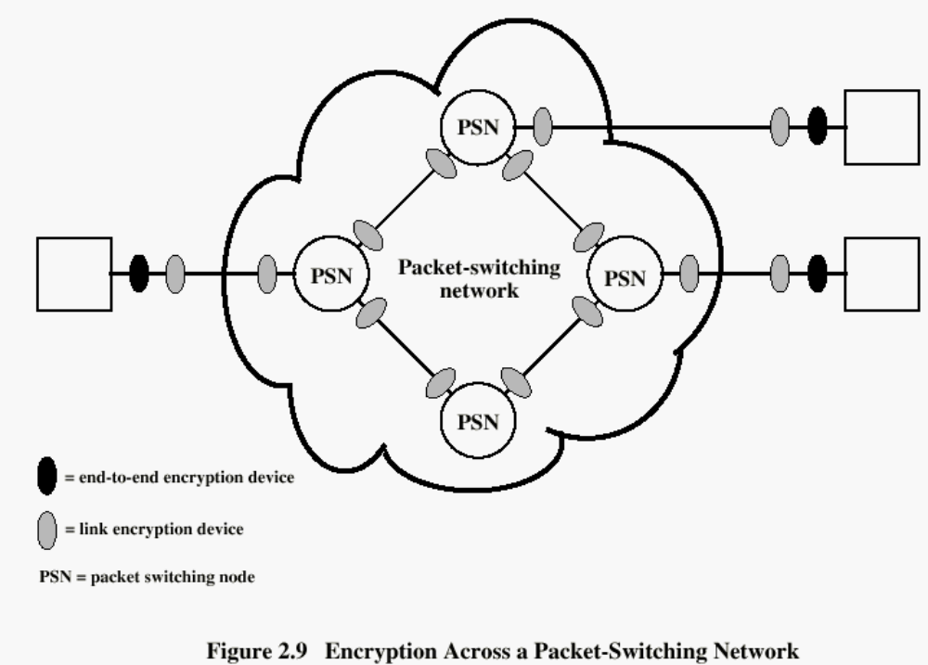

Slide 57
Key Distribution
Physical delivery
  A key could be selected by A and physically delivered to B.
  A third party could select the key and physically deliver it to A and B.
Network transfer
  If A and B have previously used a key, one party could transmit the new key to the other, encrypted using the old key.
  If A and B each has an encrypted connection to a third party C, C could deliver a key on the encrypted links to A and B.
  Diffie-Hellman key exchange

Slide 58
Session and Permanent Key
Session key:
  Data encrypted with a one-time session key
  At the conclusion of the session, the key is destroyed
Permanent key:
  Used between entities for the purpose of distributing session keys

Slide 59
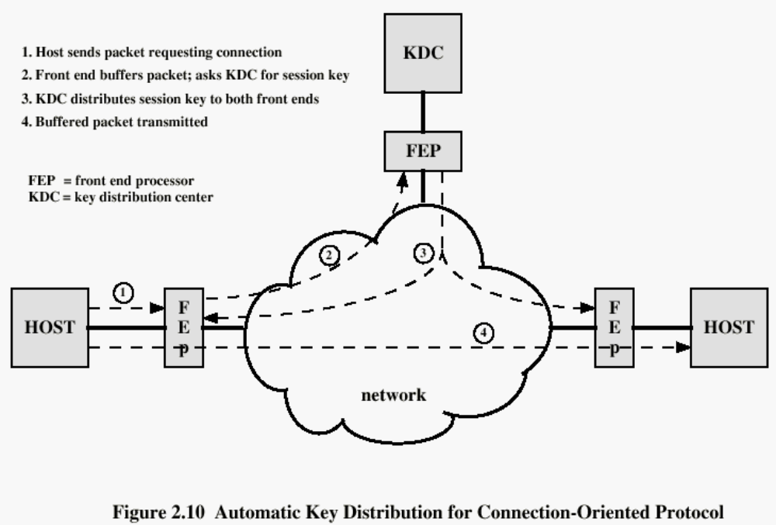

Slide 60
Recommended Reading
Scneier, B. Applied Cryptography, New York: Wiley, 1996
Mel, H.X. Baker, D. Cryptography Decrypted. Addison Wesley, 2001

